Slide 1
CSE/T/324A Computer Networks Topic 11- Application Layer DNS, Remote login, e-mail, FTP
Sarbani Roy
sarbani.roy@jadavpuruniversity.in
Office: CC-5-7
Cell: 9051639328

Slide 2
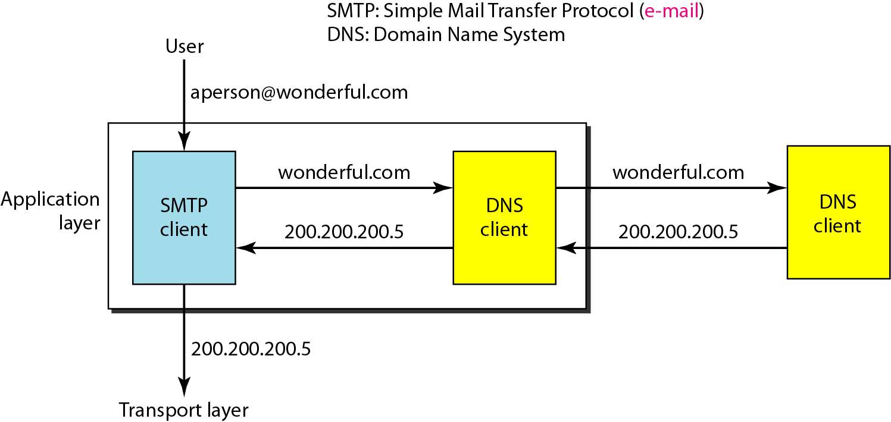
Example of using the DNS service

Slide 3
NAME SPACE
To be unambiguous, the names assigned to machines must be carefully selected from a name space with complete control over the binding between the names and IP addresses.
Topics discussed in this section:
Flat Name Space Hierarchical Name Space

Slide 4
DOMAIN NAME SPACE
To have a hierarchical name space, a domain name space was designed. In this design the names are defined in an inverted-tree structure with the root at the top. The tree can have only 128 levels: level 0 (root) to level 127.
Topics discussed in this section:
Label Domain Name Domain

Slide 5
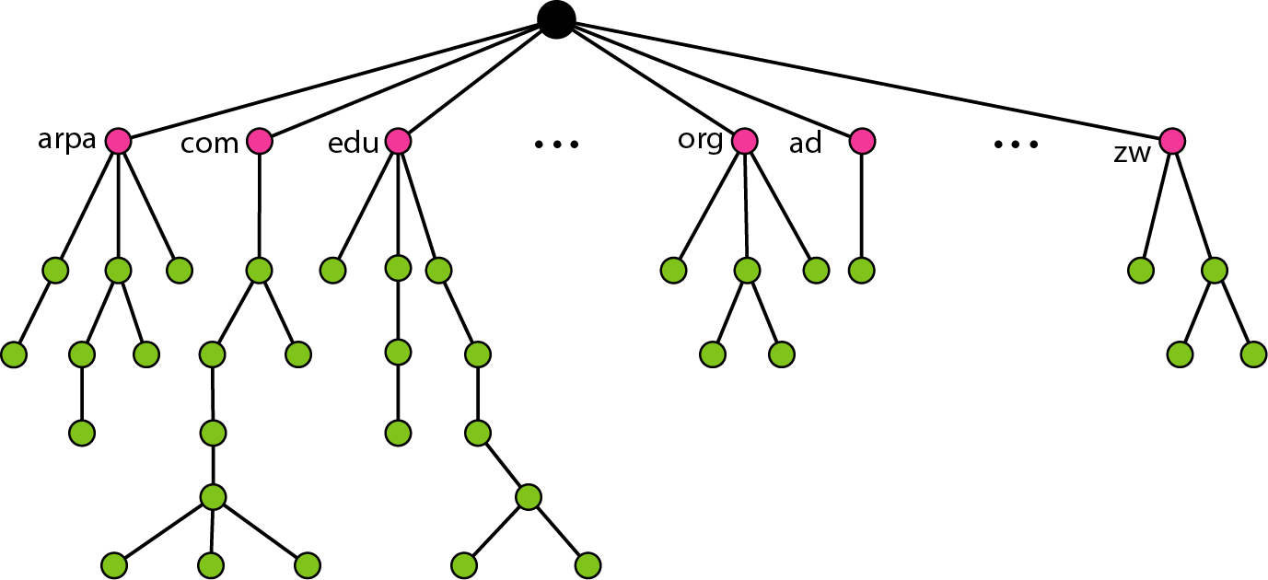
Domain name space

Slide 6
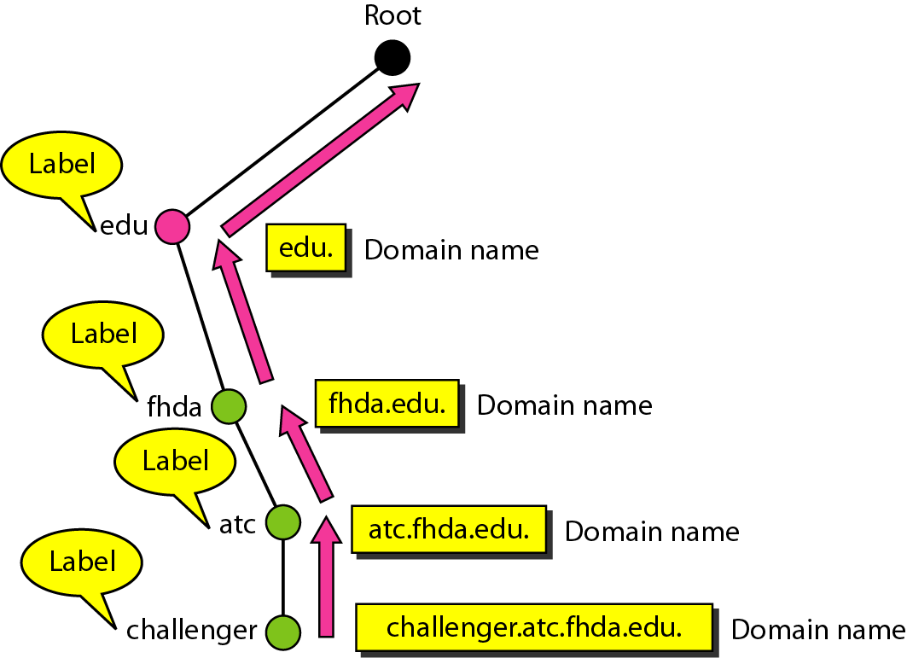
Domain names and labels

Slide 7
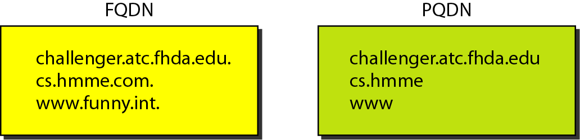
FQDN and PQDN

Slide 8
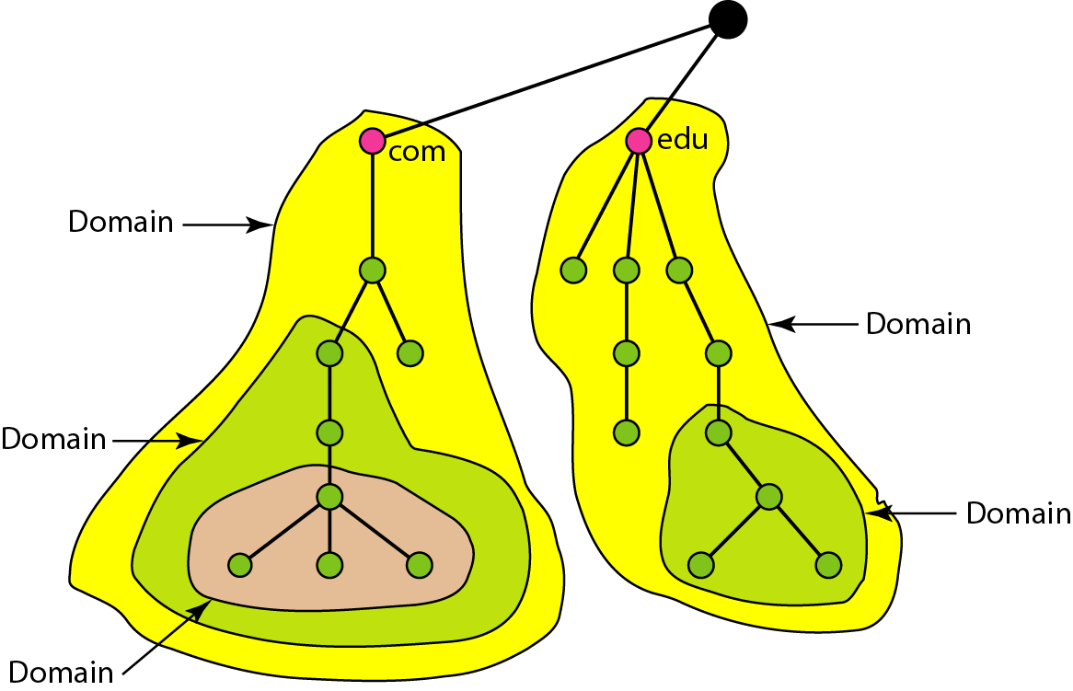
Domains

Slide 9
DISTRIBUTION OF NAME SPACE
The information contained in the domain name space must be stored. However, it is very inefficient and also unreliable to have just one computer store such a huge amount of information. In this section, we discuss the distribution of the domain name space.
Topics discussed in this section:
Hierarchy of Name Servers
Zone Root Server Primary and Secondary Servers

Slide 10
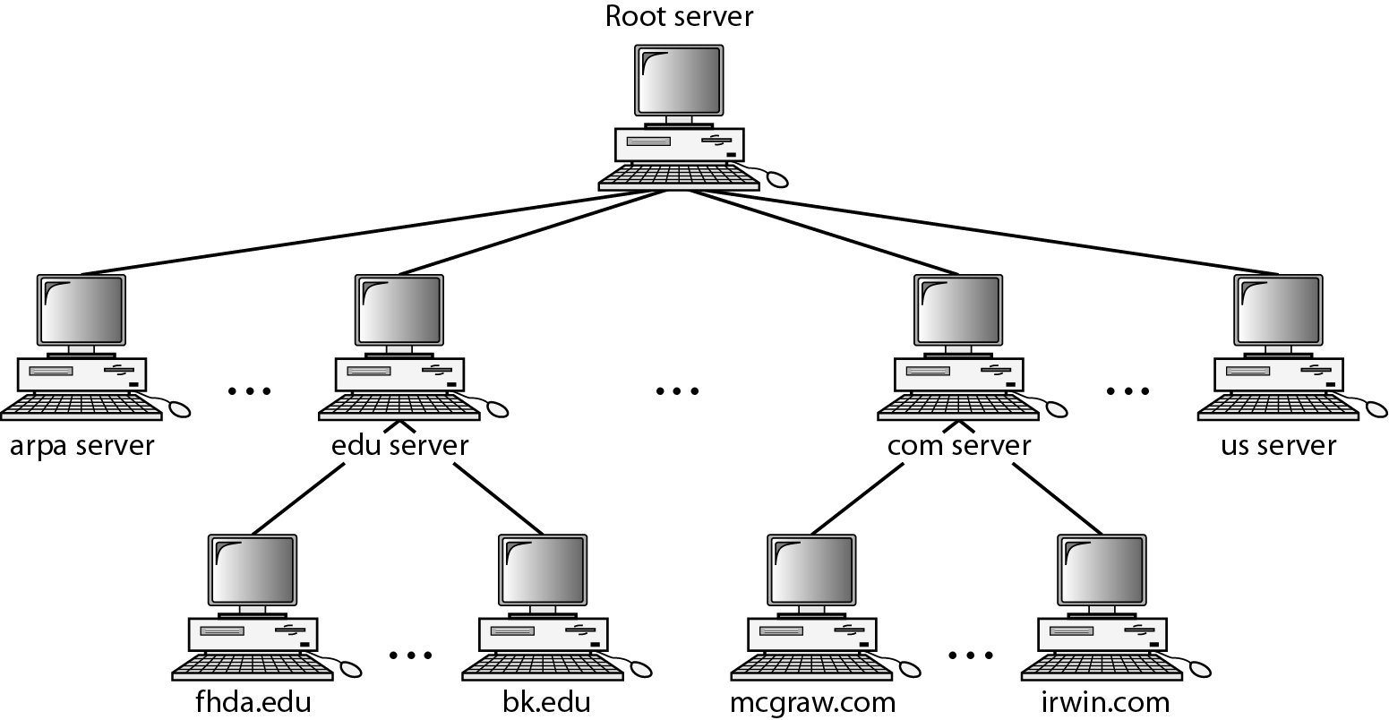
Hierarchy of name servers

Slide 11
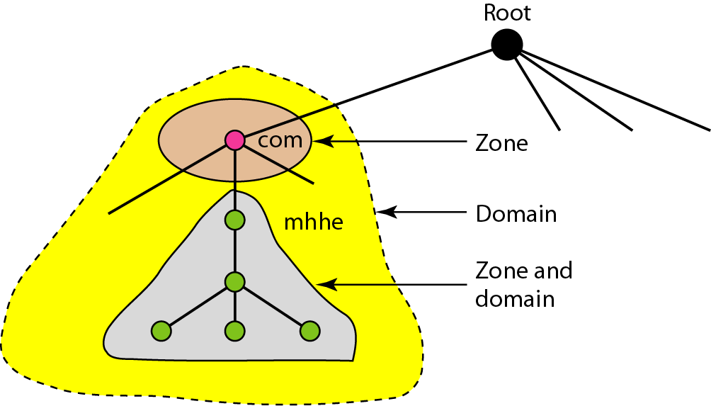
Zones and domains

Slide 12

Note
A primary server loads all information from the disk file; the secondary server
loads all information from the primary server.
When the secondary downloads
information from the primary, it is called zone transfer.

Slide 13
DNS IN THE INTERNET
DNS is a protocol that can be used in different platforms. In the Internet, the domain name space (tree) is divided into three different sections: generic domains, country domains, and the inverse domain.
Topics discussed in this section:
Generic Domains Country Domains Inverse Domain

Slide 14
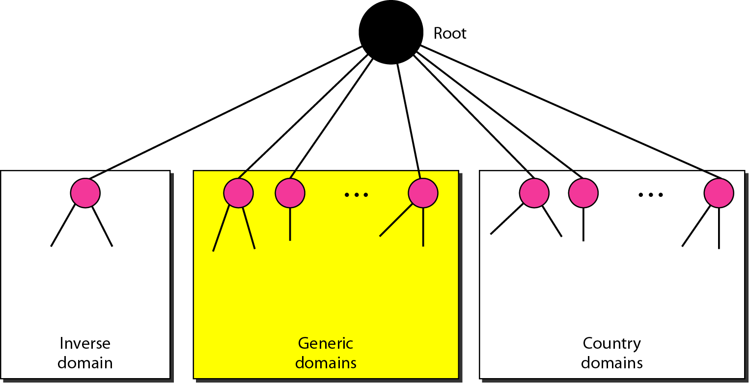
DNS IN THE INTERNET

Slide 15
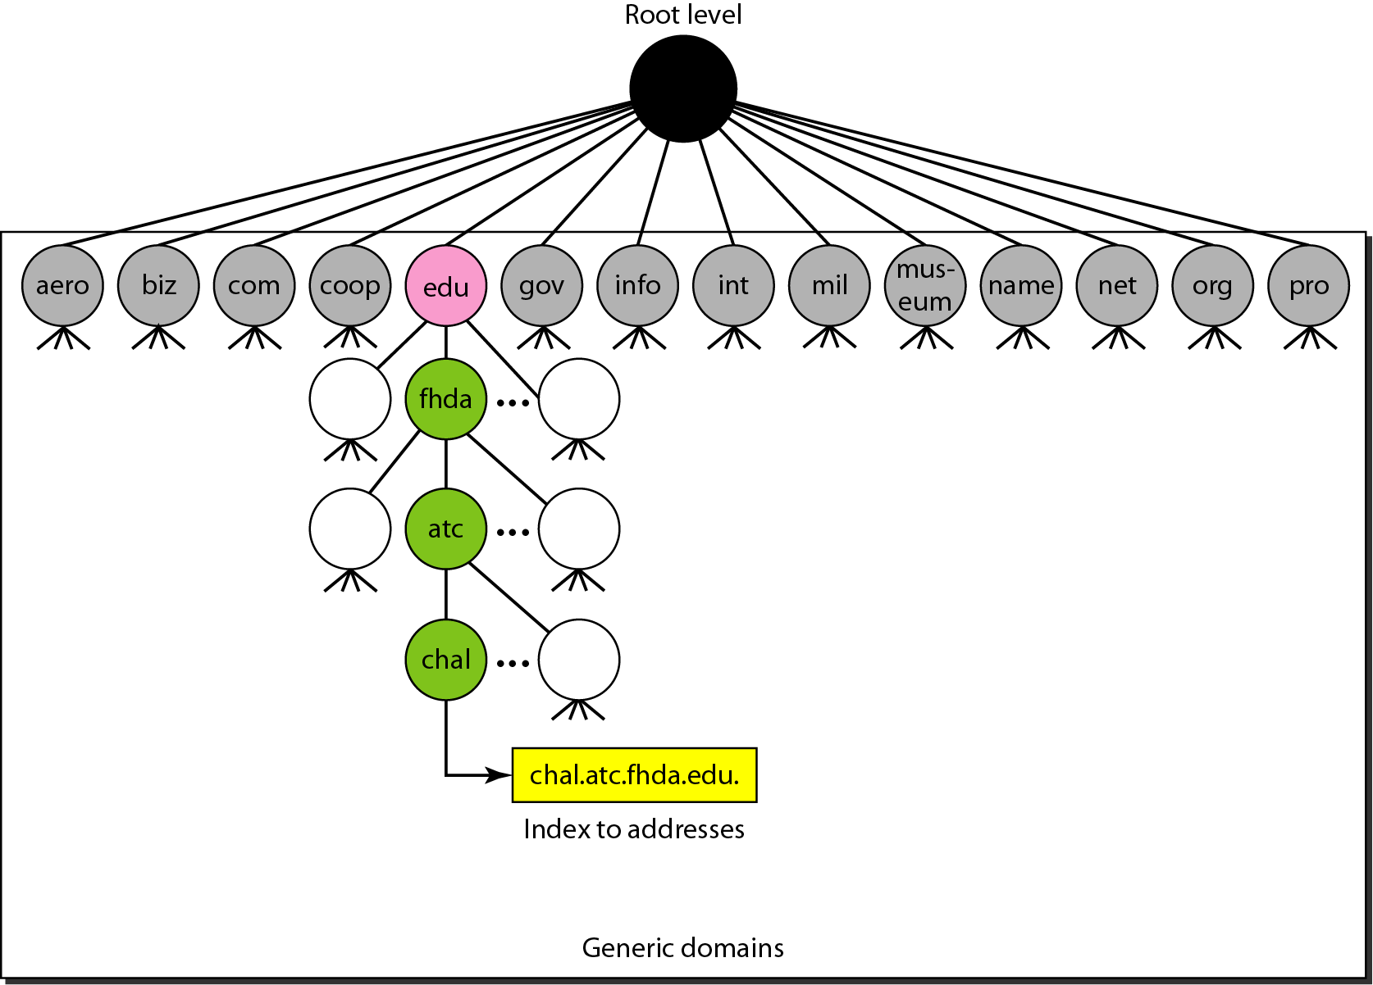
Generic domains

Slide 16
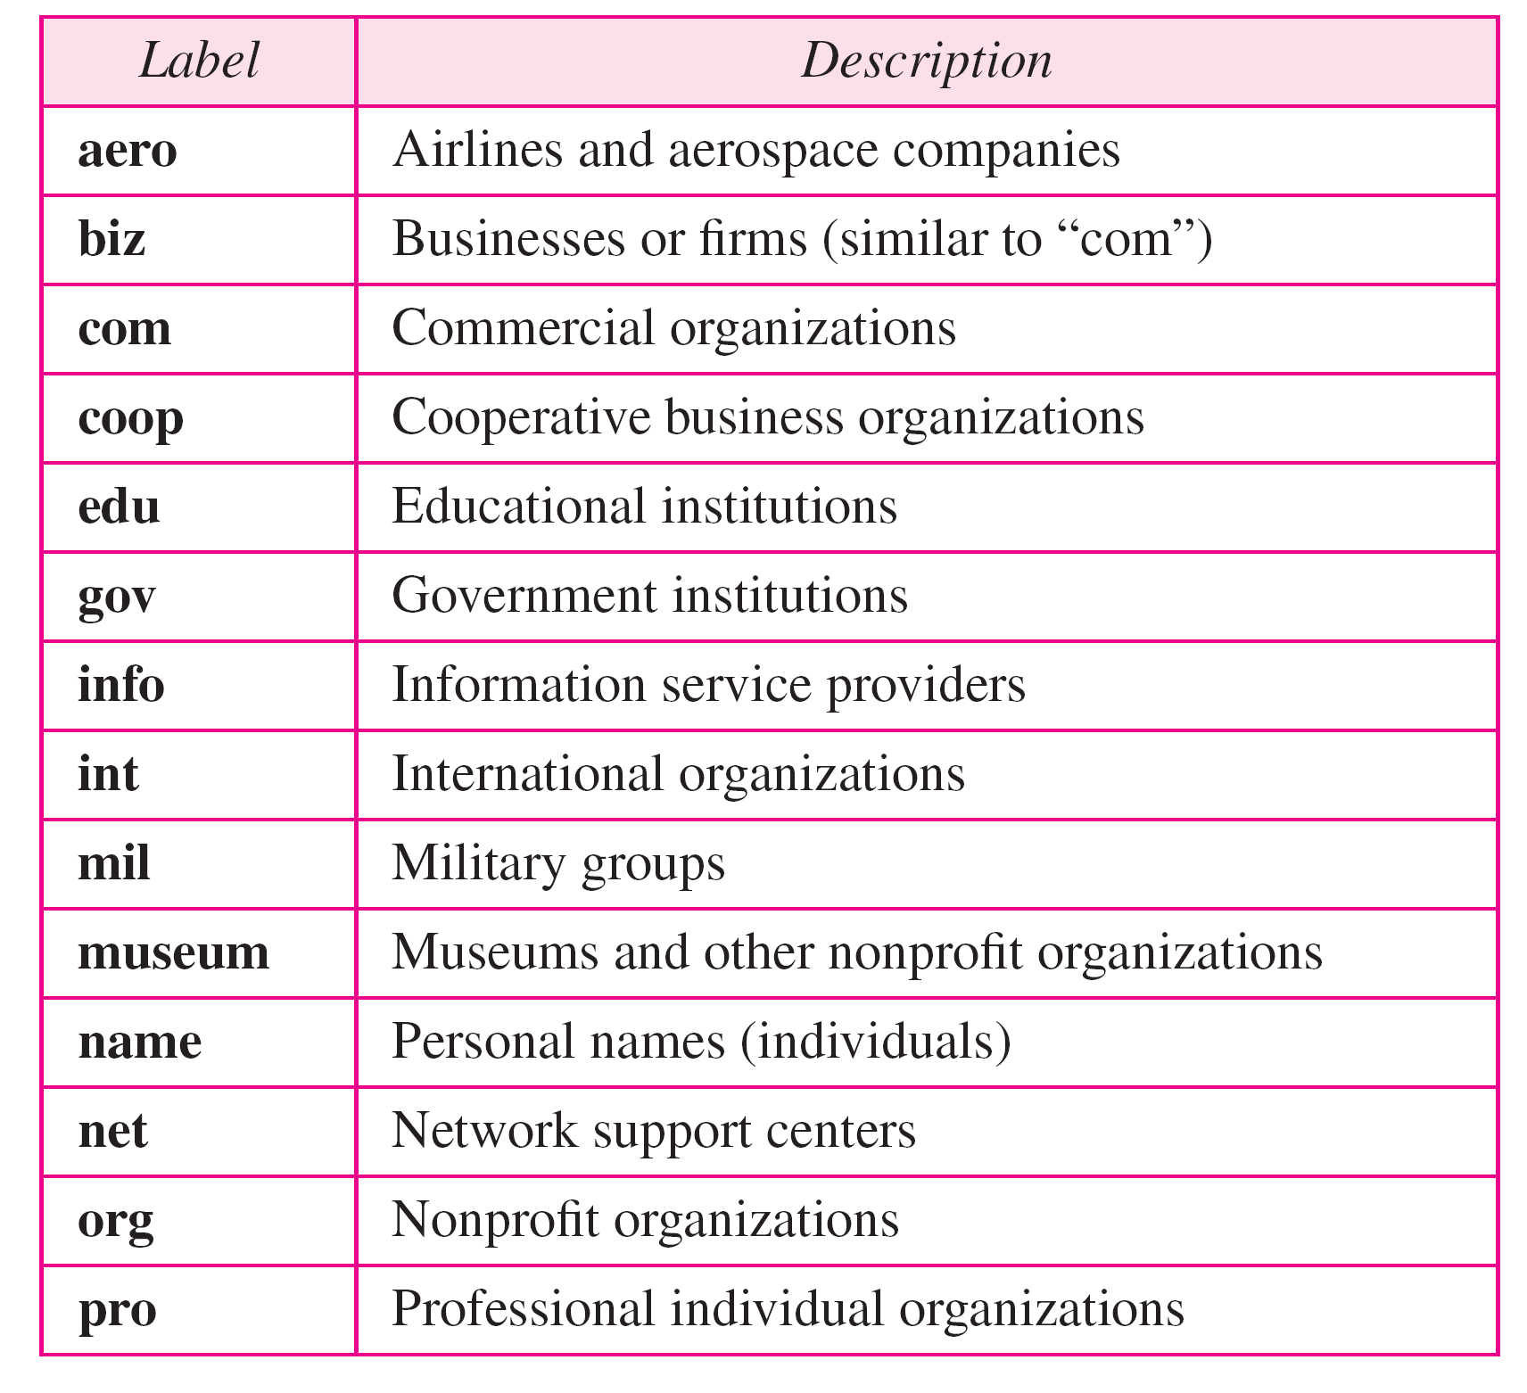
Generic domain labels

Slide 17
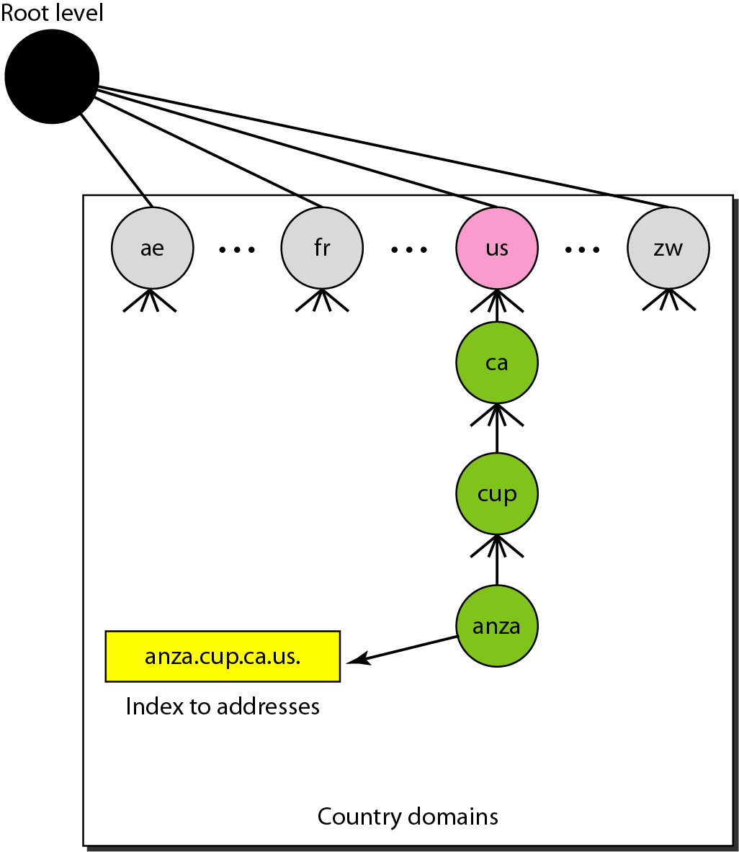
Country domains

Slide 18
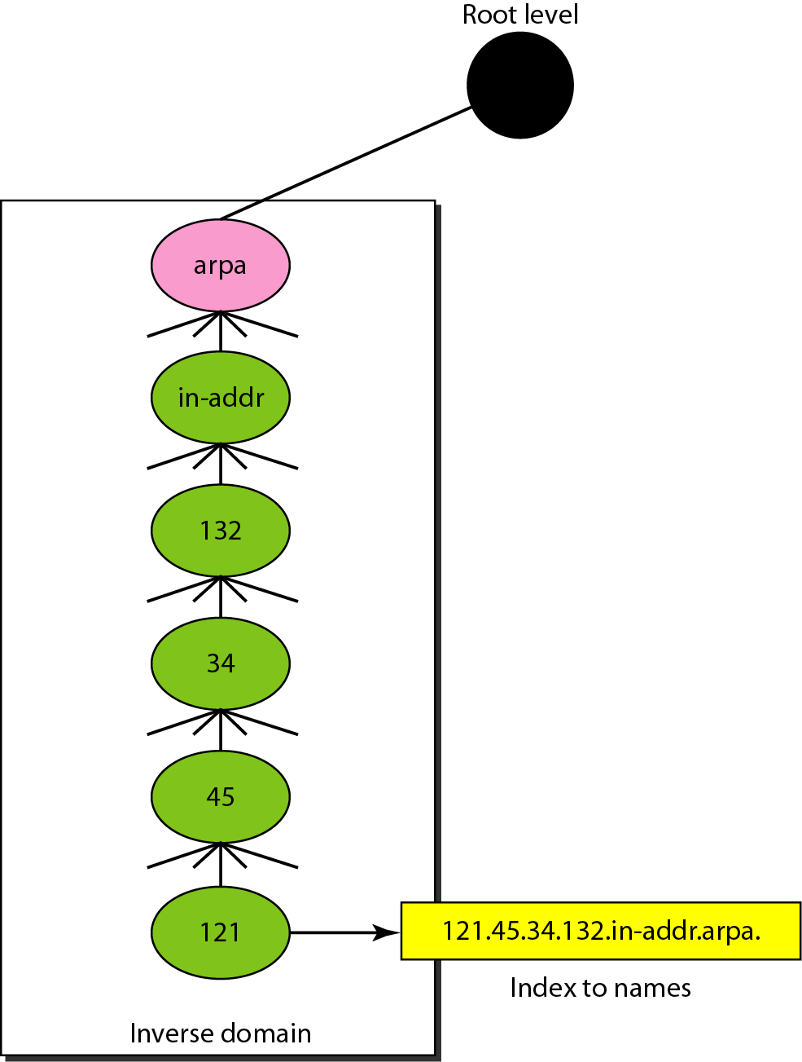
Inverse domain

Slide 19
RESOLUTION
Mapping a name to an address or an address to a name is called name-address resolution.
Topics discussed in this section:
Resolver Mapping Names to Addresses Mapping Addresses to Names
Recursive Resolution
Caching

Slide 20
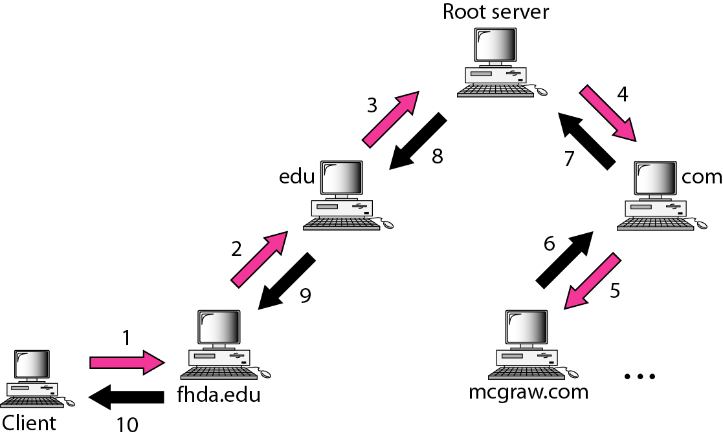
Recursive resolution

Slide 21
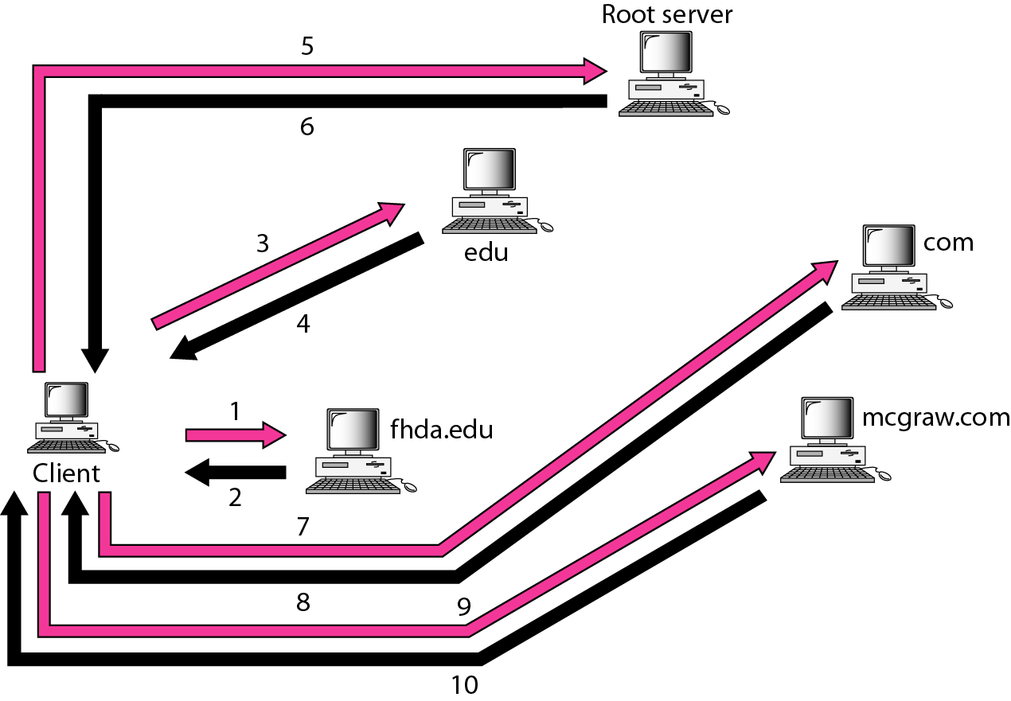
Iterative resolution

Slide 22
DNS MESSAGES
DNS has two types of messages: query and response. Both types have the same format. The query message consists of a header and question records; the response message consists of a header, question records, answer records, authoritative records, and additional records.
Topics discussed in this section:
Header

Slide 23
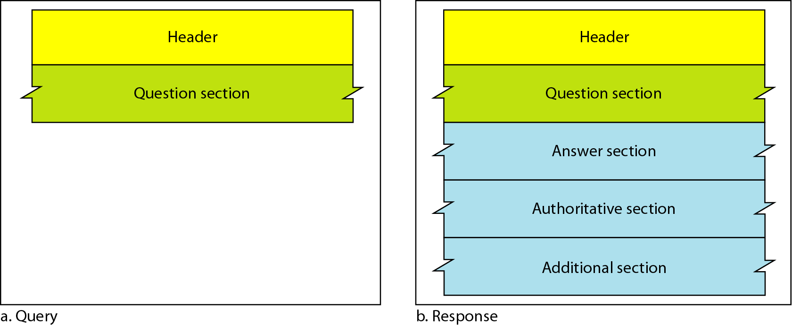
Query and response messages

Slide 24
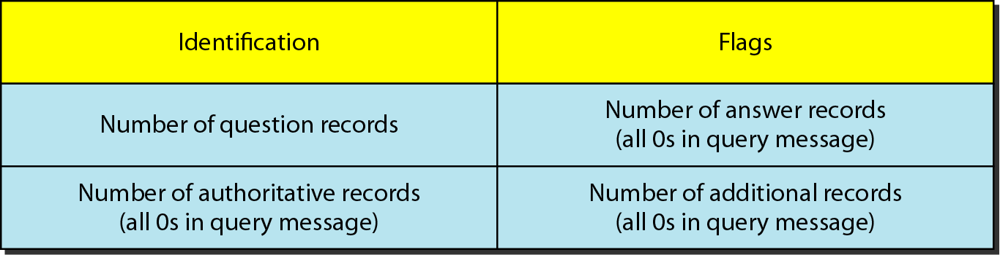
Header format

Slide 25
TYPES OF RECORDS
Two types of records are used in DNS. The question records are used in the question section of the query and response messages. The resource records are used in the answer, authoritative, and additional information sections of the response message.
Topics discussed in this section:
Question Record
Resource Record

Slide 26
REGISTRARS
How are new domains added to DNS? This is done through a registrar, a commercial entity accredited by ICANN. A registrar first verifies that the requested domain name is unique and then enters it into the DNS database. A fee is charged.

Slide 27
DYNAMIC DOMAIN NAME SYSTEM (DDNS)
The DNS master file must be updated dynamically. The Dynamic Domain Name System (DDNS) therefore was devised to respond to this need. In DDNS, when a binding between a name and an address is determined, the information is sent, usually by DHCP to a primary DNS server. The primary server updates the zone. The secondary servers are notified either actively or passively.

Slide 28
ENCAPSULATION
DNS can use either UDP or TCP. In both cases the well-known port used by the server is port 53. UDP is used when the size of the response message is less than 512 bytes because most UDP packages have a 512-byte packet size limit. If the size of the response message is more than 512 bytes, a TCP connection is used.

Slide 29
Note
DNS can use the services of UDP or TCP using the well-known port 53.

Slide 30
REMOTE LOGGING
It would be impossible to write a specific client/server program for each demand. The better solution is a general-purpose client/server program that lets a user access any application program on a remote computer.
Topics discussed in this section:
TELNET

Slide 31
Note
TELNET is a general-purpose client/server application program.

Slide 32
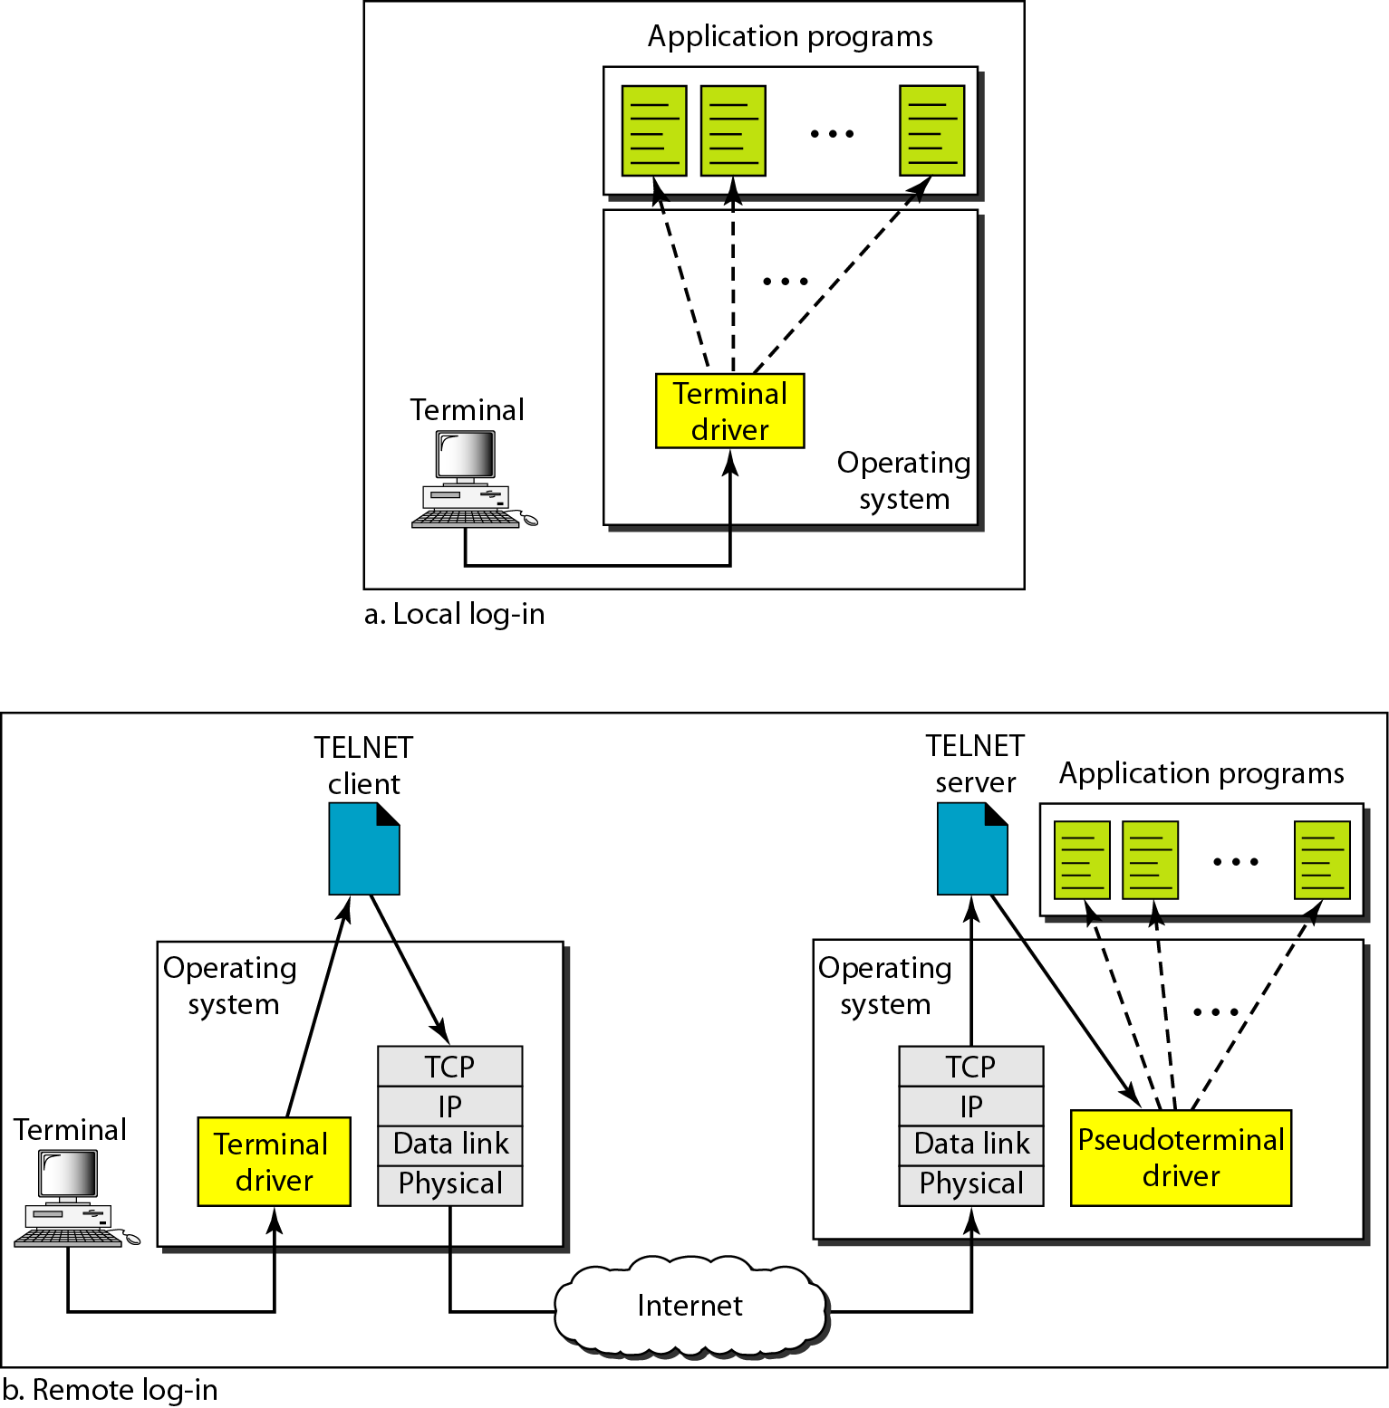
Local and remote log-in

Slide 33
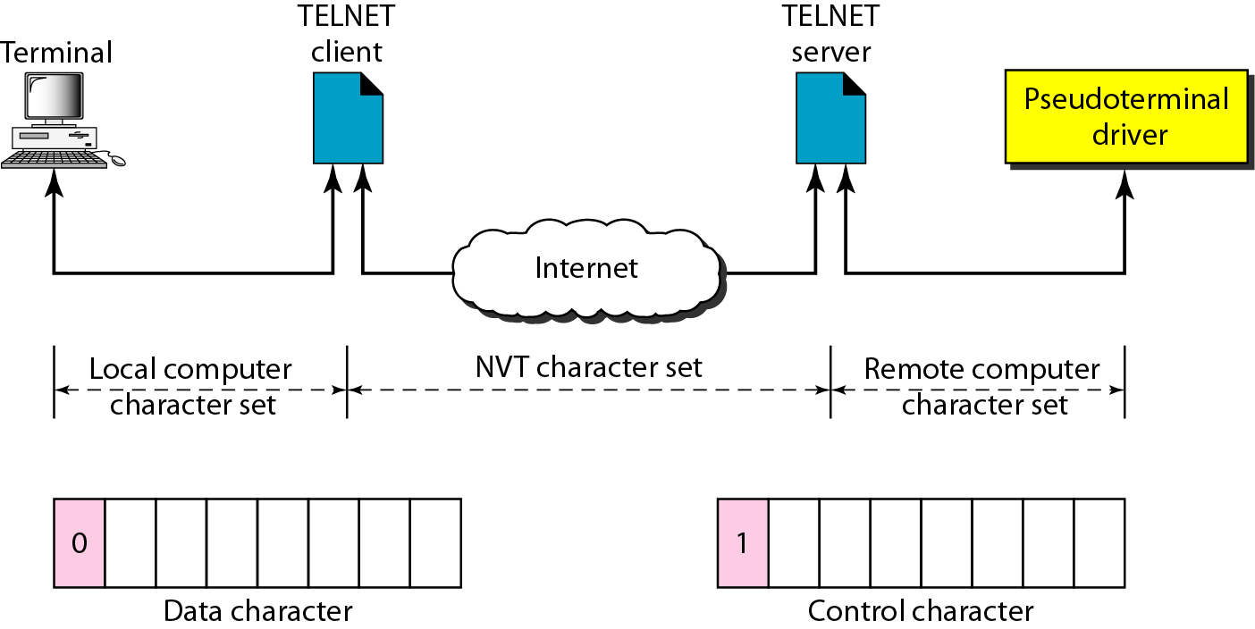
Concept of NVT

Slide 34
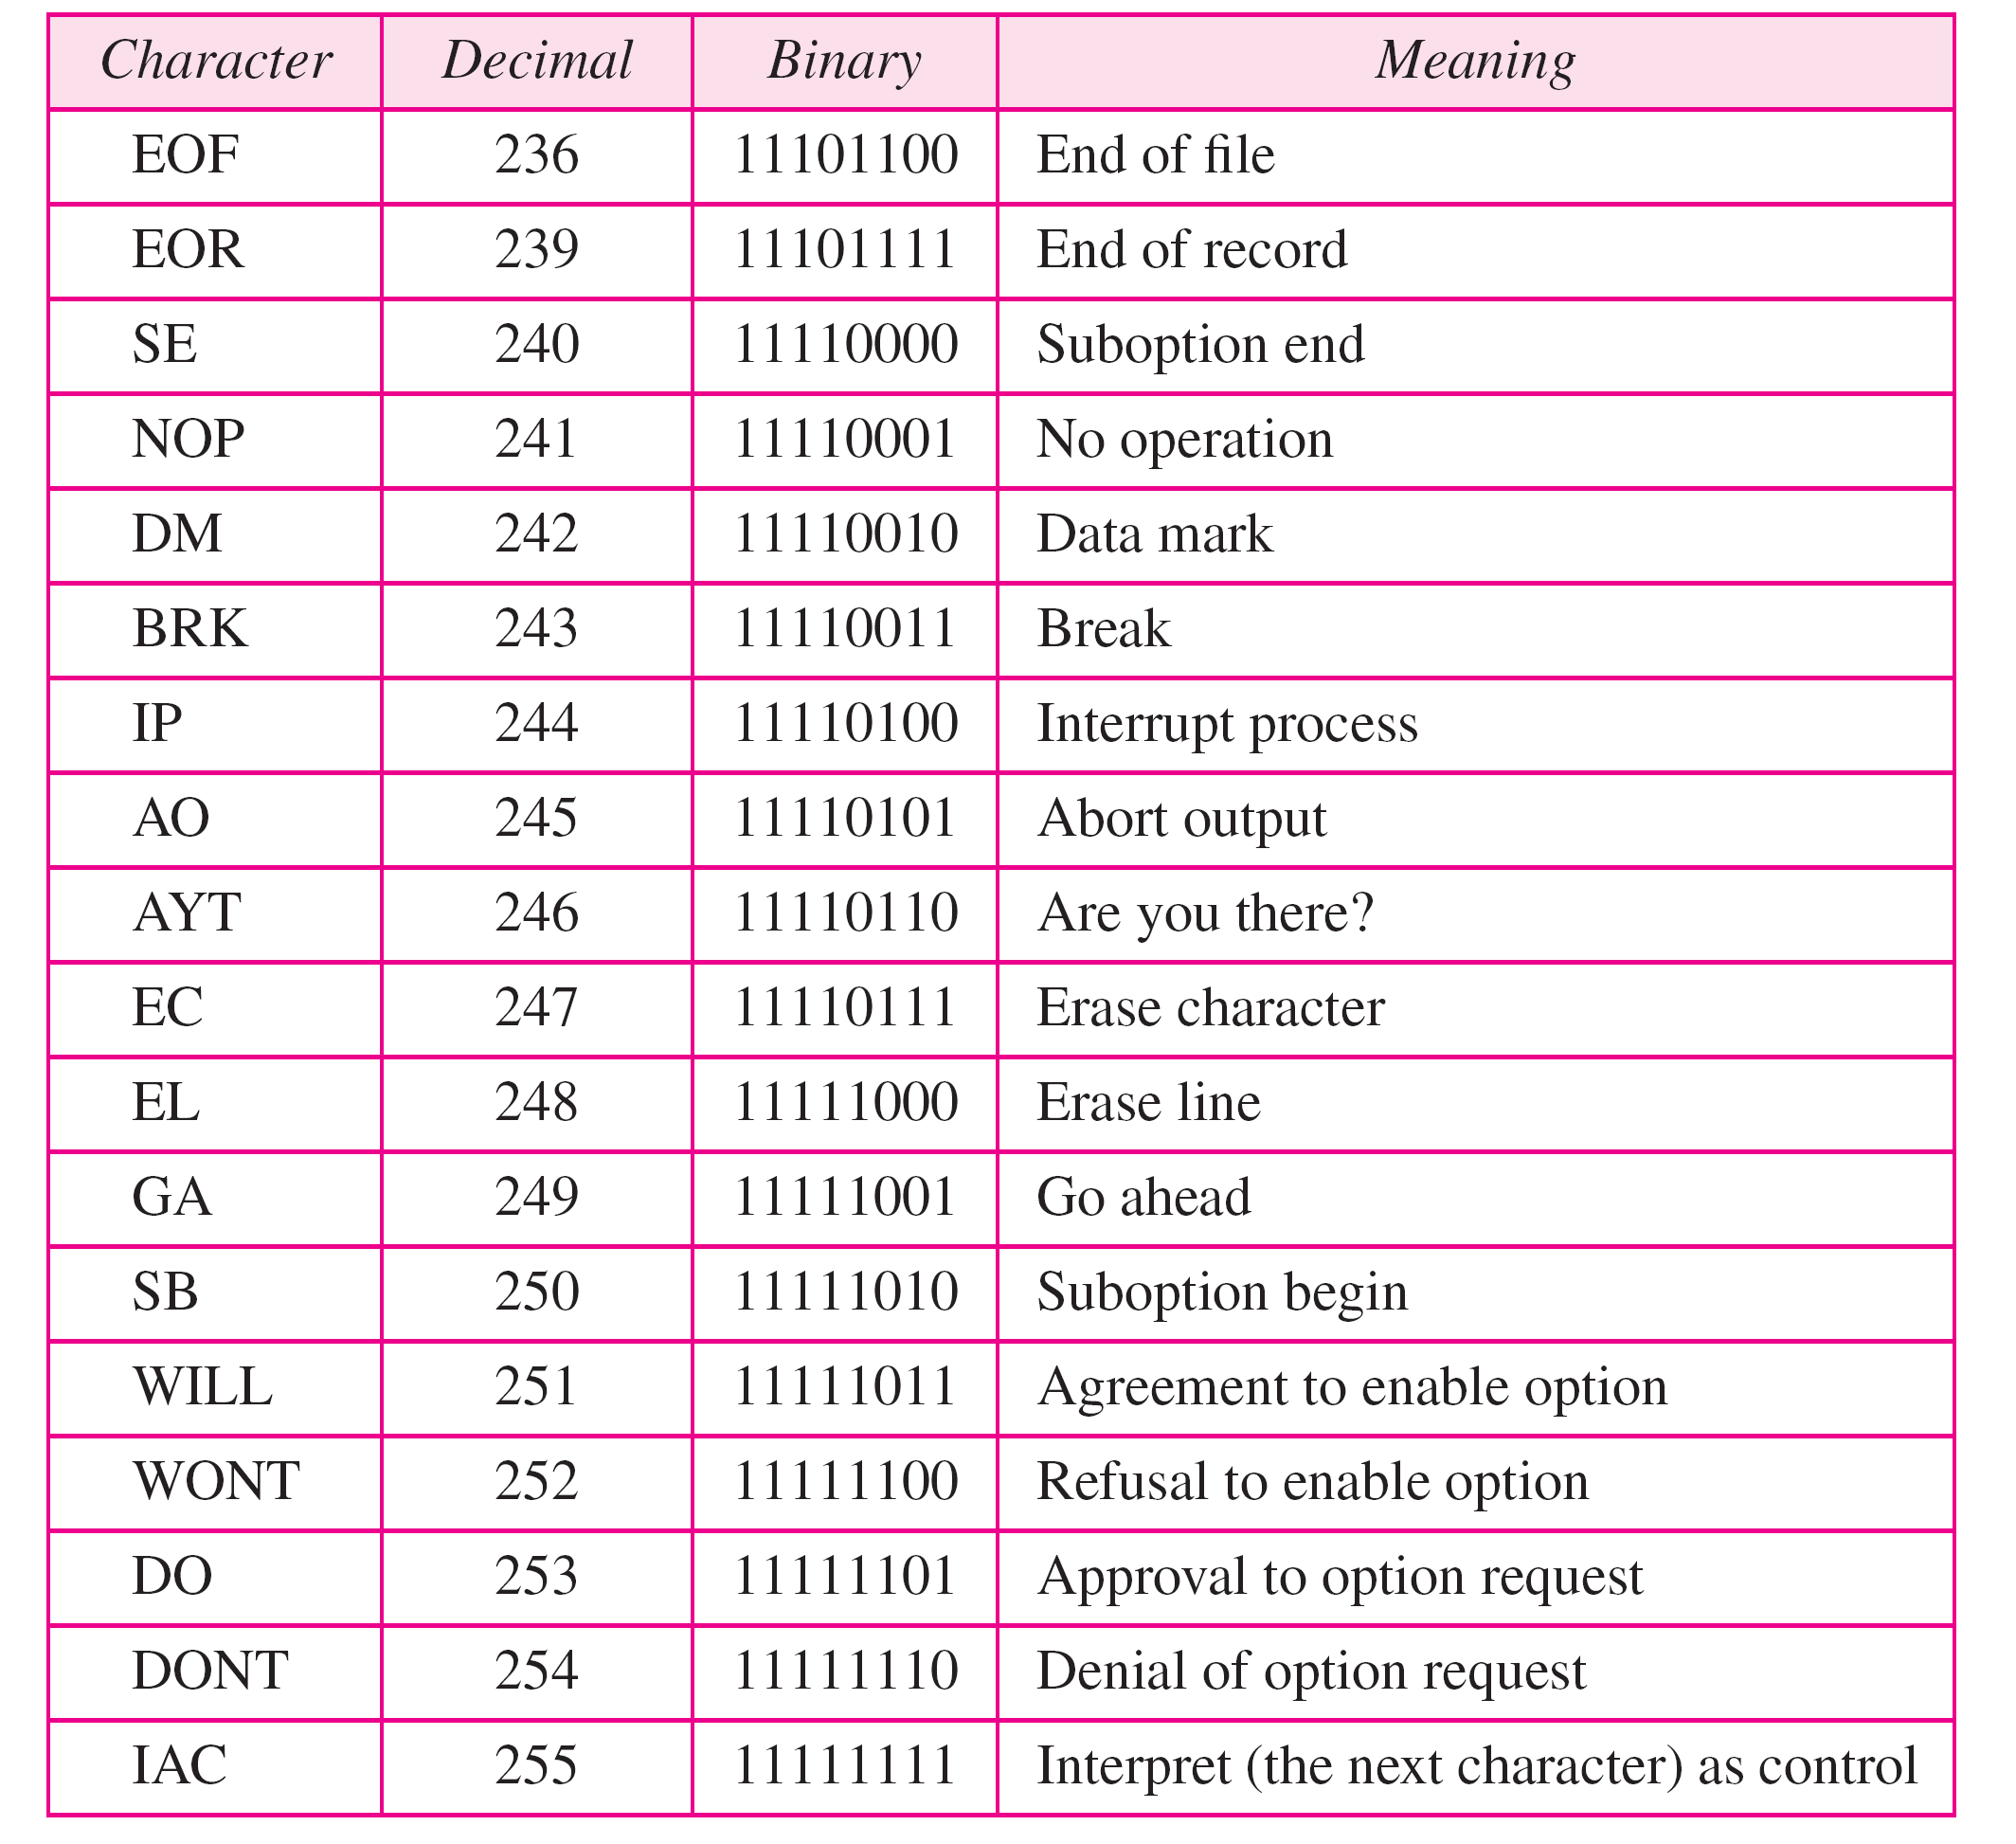
Some NVT control characters

Slide 35
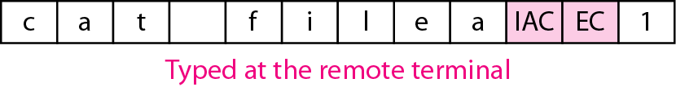
An example of embedding

Slide 36
Options

Slide 37
NVT character set for option negotiation

Slide 38
Example
Figure shows an example of option negotiation. In this example, the client wants the server to echo each character sent to the server. The echo option is enabled by the server because it is the server that sends the characters back to the user terminal. Therefore, the client should request from the server the enabling of the option using DO. The request consists of three characters: IAC, DO, and ECHO. The server accepts the request and enables the option. It informs the client by sending the three-character approval: IAC, WILL, and ECHO.

Slide 39
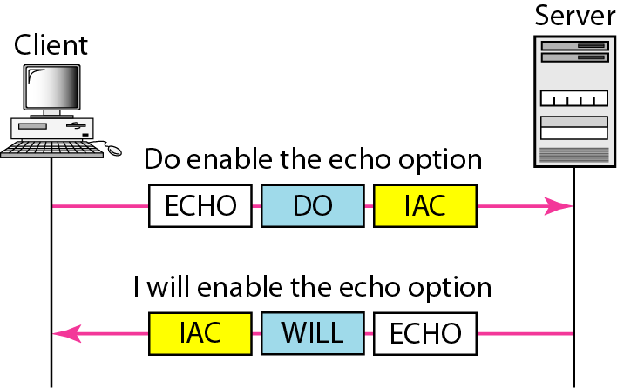
Figure Example : Echo option

Slide 40
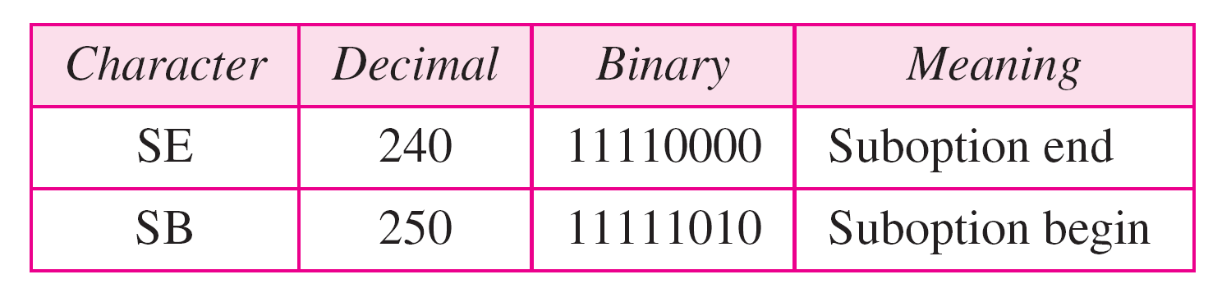
Table Character set for suboptions

Slide 41
Example
Figure shows an example of suboption negotiation. In this example, the client wants to negotiate the type of the terminal.

Slide 42
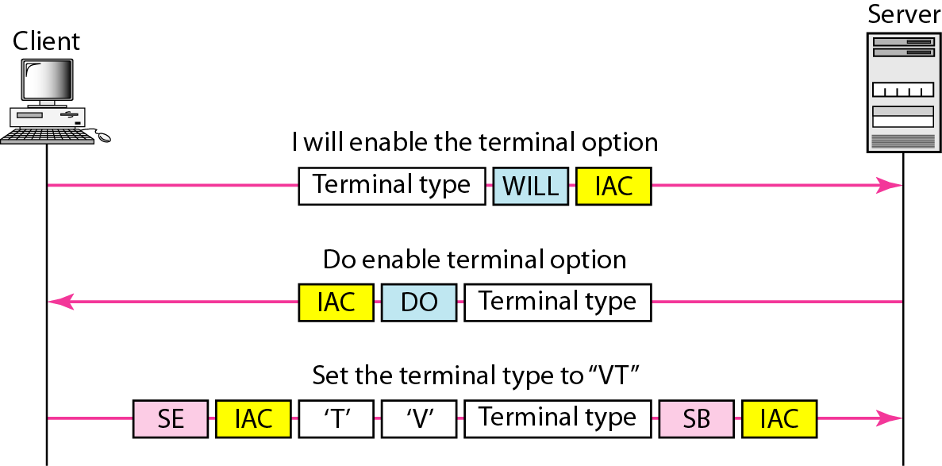
Figure Example of suboption negotiation

Slide 43
ELECTRONIC MAIL
One of the most popular Internet services is electronic mail (e-mail). The designers of the Internet probably never imagined the popularity of this application program. Its architecture consists of several components that we discuss in this chapter.
Topics discussed in this section:
Architecture User Agent
Message Transfer Agent: SMTP
Message Access Agent: POP and IMAP
Web-Based Mail

Slide 44
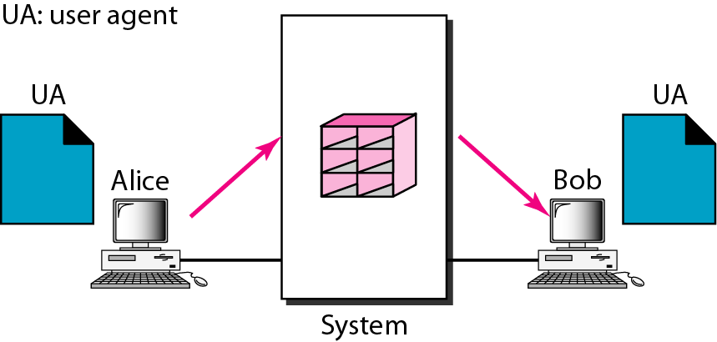
First scenario in electronic mail

Slide 45
Note
When the sender and the receiver of an e-mail are on the same system,
we need only two user agents.

Slide 46
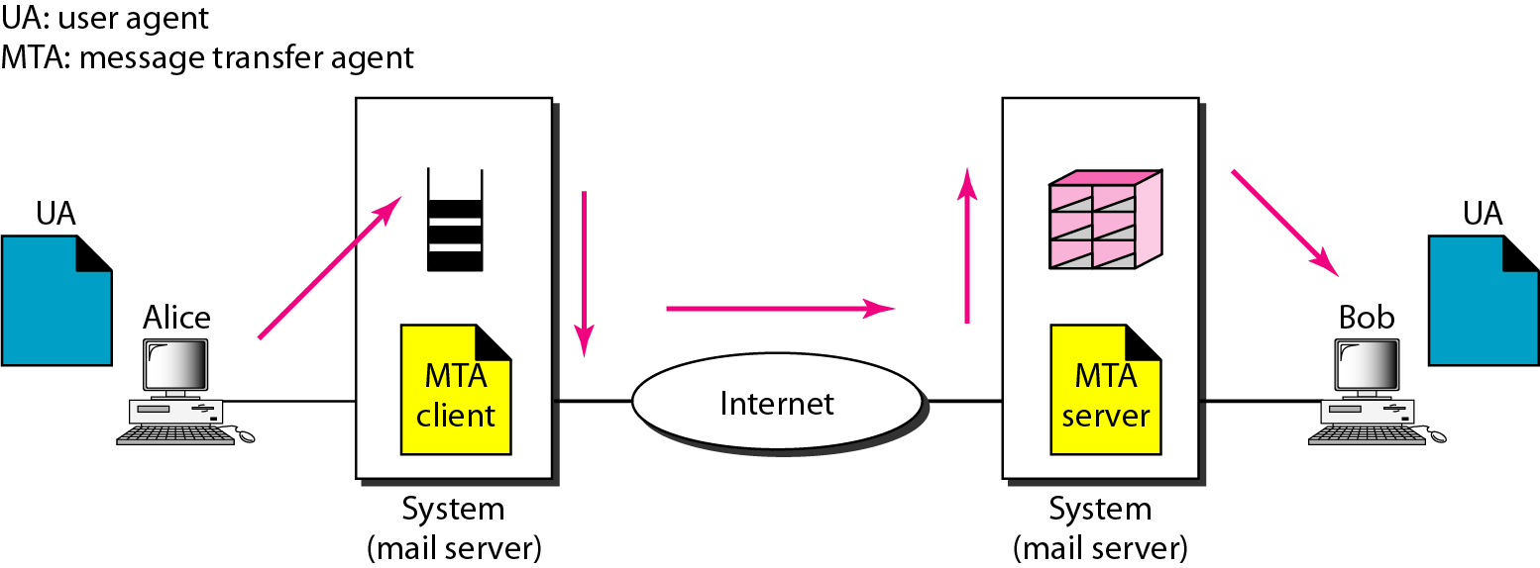
Second scenario in electronic mail

Slide 47
Note
When the sender and the receiver of an e-mail are on different systems, we
need two UAs and a pair of MTAs (client and server).

Slide 48
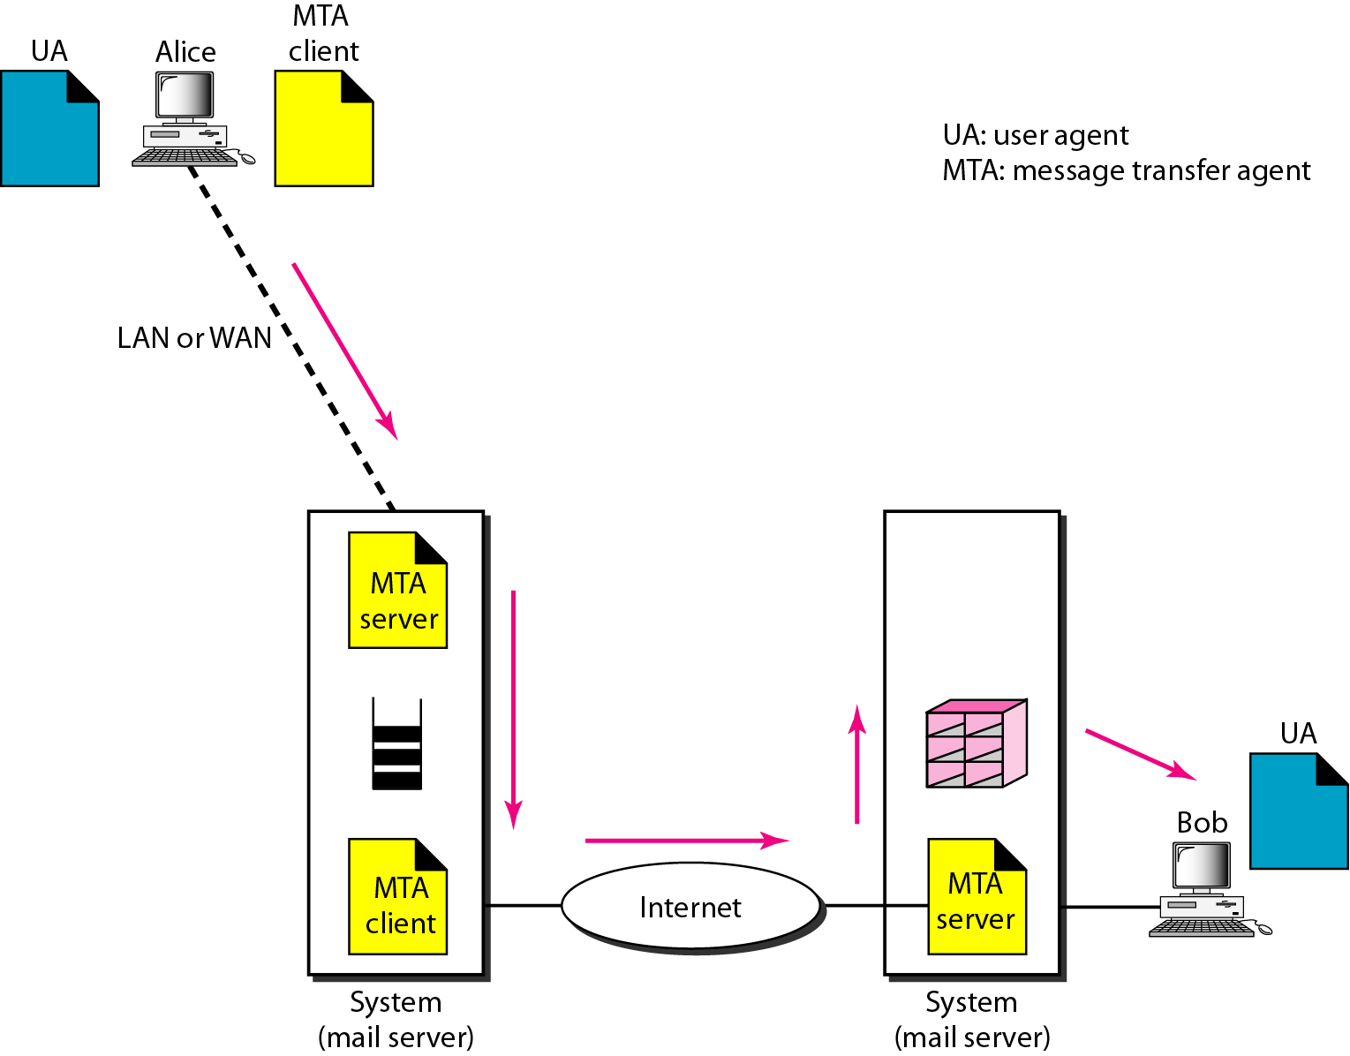
Third scenario in electronic mail

Slide 49
Note
When the sender is connected to the mail server via a LAN or a WAN,
we need two UAs and two pairs
of MTAs (client and server).

Slide 50
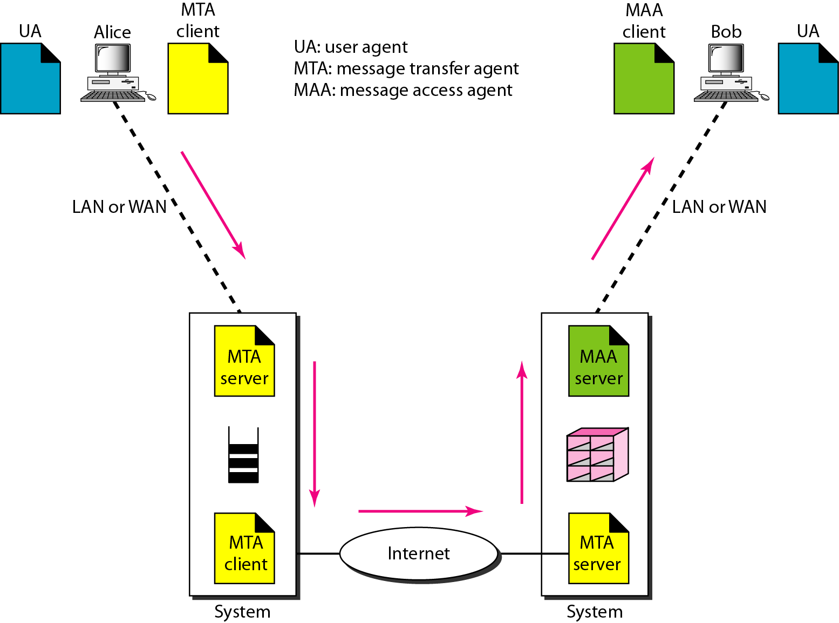
Fourth scenario in electronic mail

Slide 51
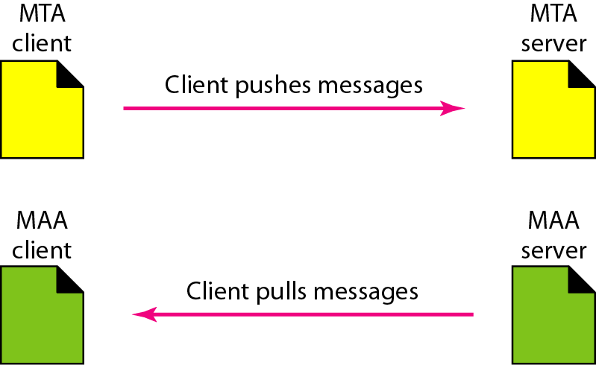
Push versus pull in electronic email

Slide 52
Note
When both sender and receiver are connected to the mail server via
a LAN or a WAN, we need two
UAs, two pairs of MTAs
and a pair of MAAs.
This is the most common situation today.

Slide 53
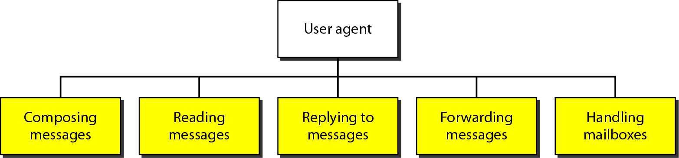
Services of user agent

Slide 54
Note
Some examples of command-driven user agents are mail, pine, and elm.

Slide 55
Note
Some examples of GUI-based user agents are Eudora, Outlook, and Netscape.

Slide 56
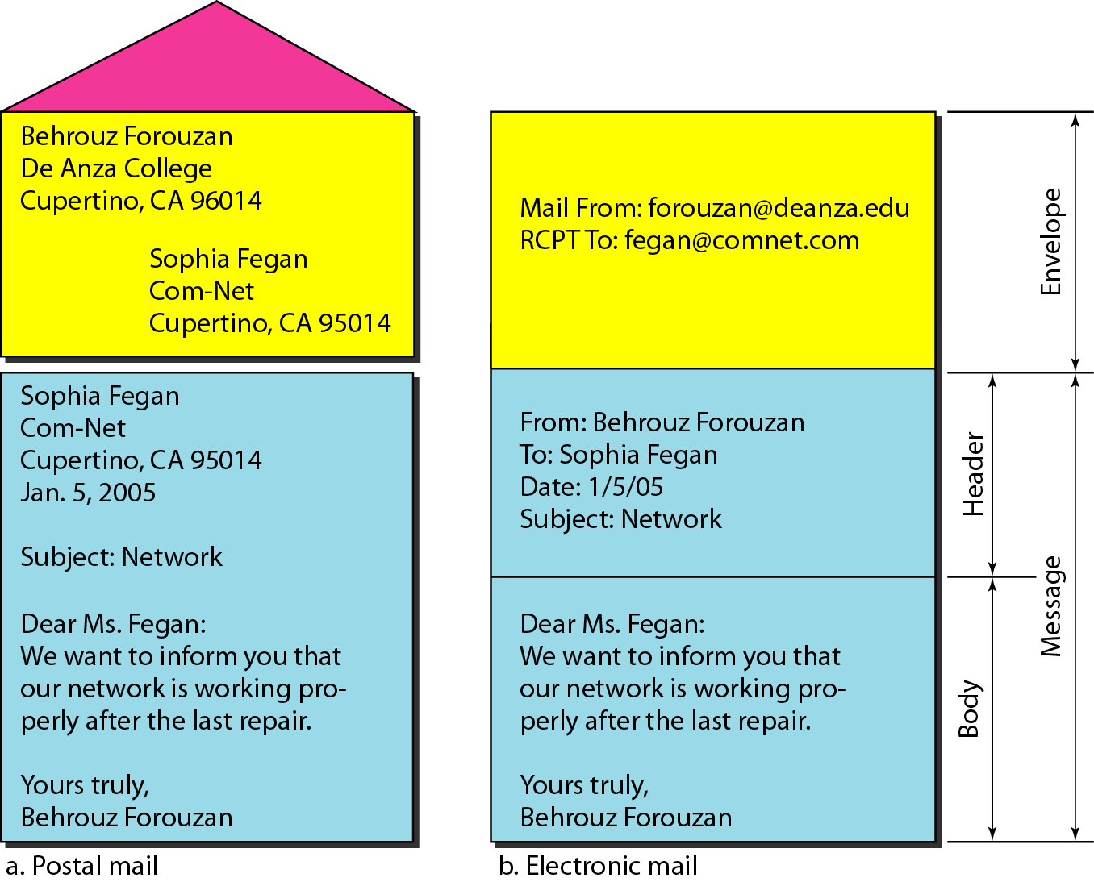
Format of an e-mail

Slide 57
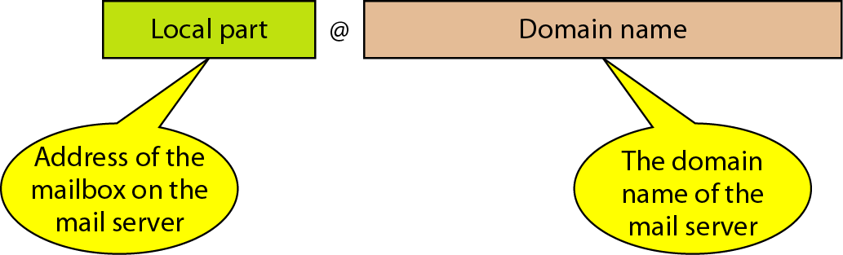
Figure 26.13 E-mail address

Slide 58
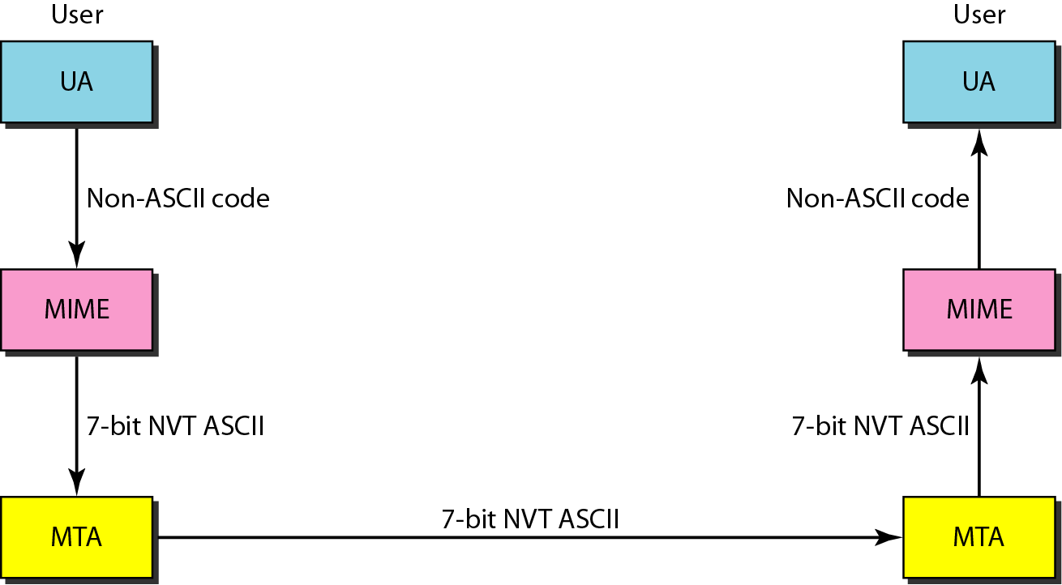
Figure 26.14 MIME

Slide 59
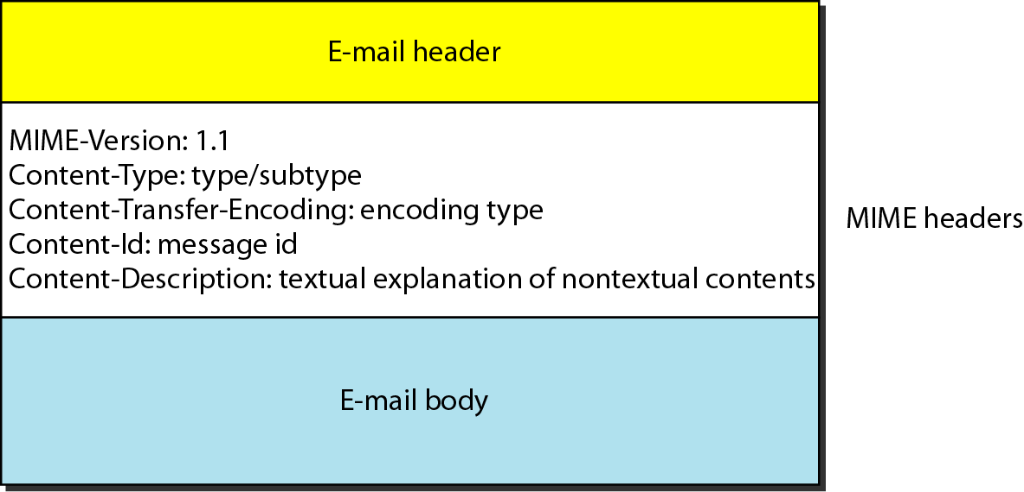
MIME header

Slide 60
Data types and subtypes in MIME

Slide 61
Content-transfer-encoding

Slide 62
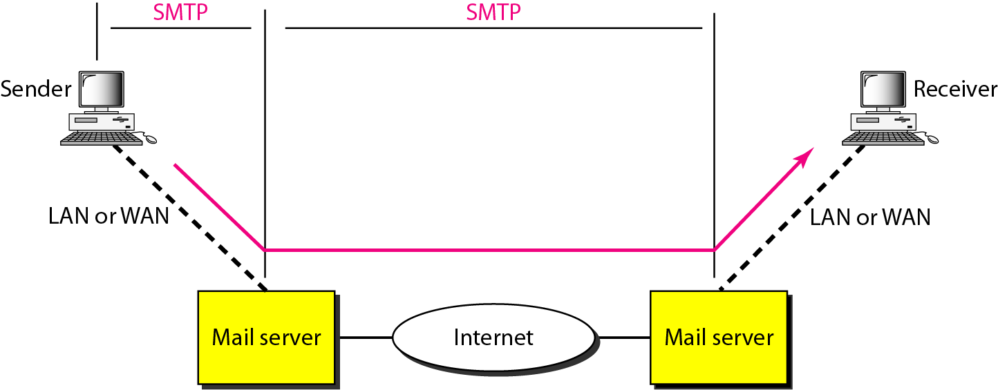
SMTP range

Slide 63
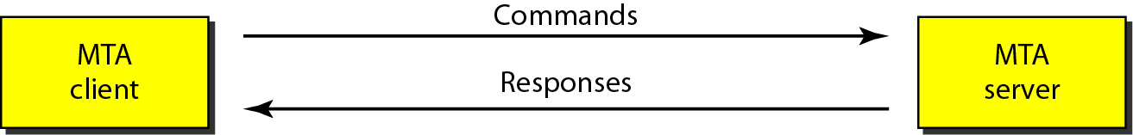
Commands and responses

Slide 64

Command format

Slide 65
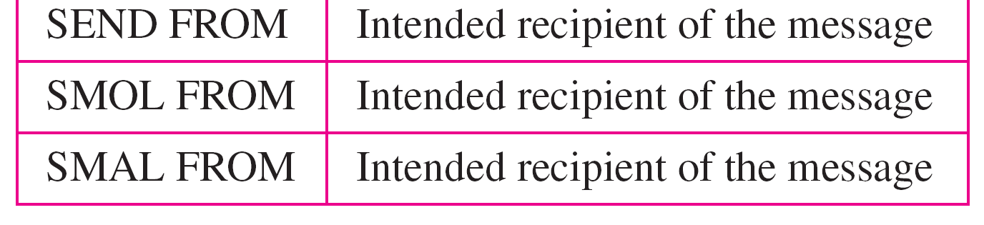
Commands

Slide 66
Responses (continued)

Slide 67
Example
Let us see how we can directly use SMTP to send an e-mail and simulate the commands and responses we described in this section. We use TELNET to log into port 25 (the well-known port for SMTP). We then use the commands directly to send an e-mail. In this example, forouzanb@adelphia.net is sending an e-mail to himself. The first few lines show TELNET trying to connect to the Adelphia mail server. After connection, we can type the SMTP commands and then receive the responses, as shown on the next slide. Note that we have added, for clarification, some comment lines, designated by the “=” signs. These lines are not part of the e-mail procedure.

Slide 68
Example (continued)
$ telnet mail.adelphia.net 25
Trying 68.168.78.100 . . .
Connected to mail.adelphia.net (68.168.78.100).

Slide 69
Example 26.3 (continued)

Slide 70
Example (continued)

Slide 71
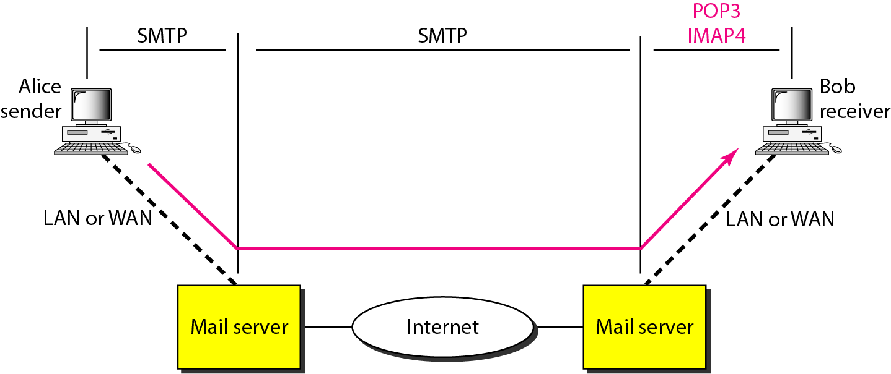
Figure POP3 and IMAP4

Slide 72
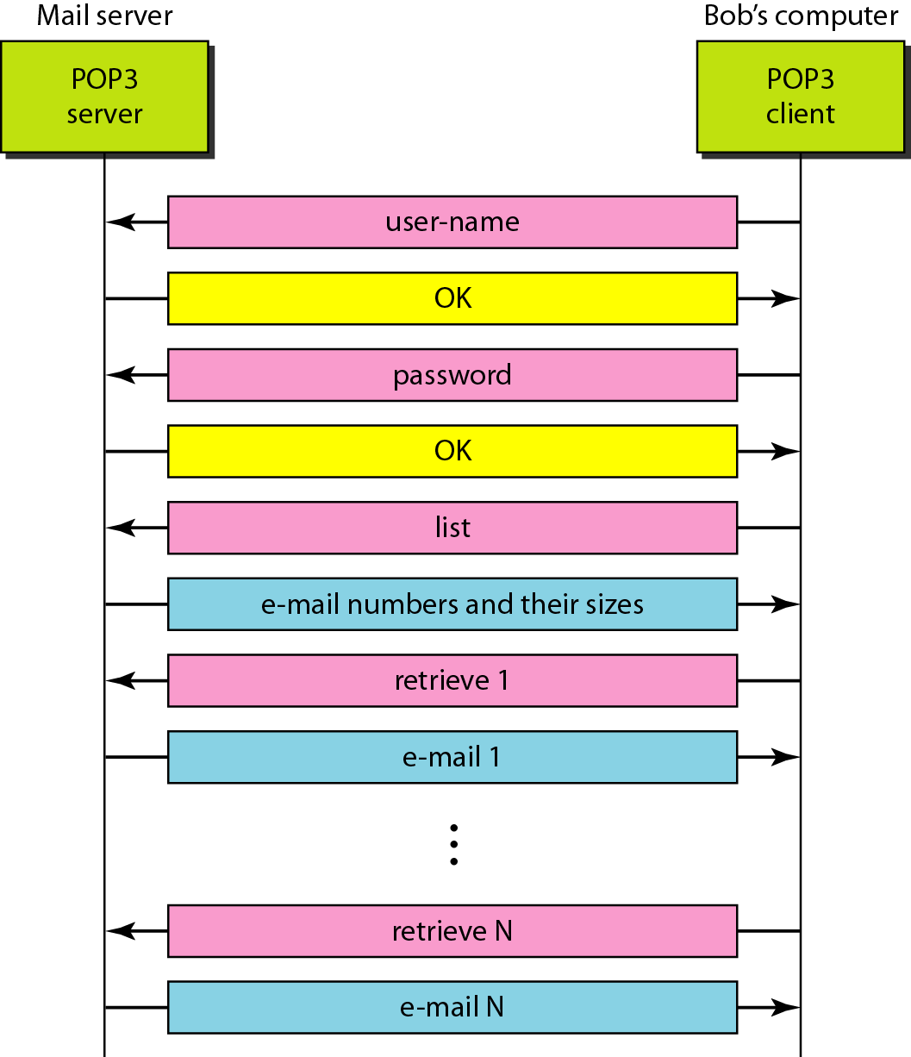
The exchange of commands and responses in POP3

Slide 73
FILE TRANSFER
Transferring files from one computer to another is one of the most common tasks expected from a networking or internetworking environment. As a matter of fact, the greatest volume of data exchange in the Internet today is due to file transfer.
Topics discussed in this section:
File Transfer Protocol (FTP) Anonymous FTP

Slide 74
Note
FTP uses the services of TCP. It needs two TCP connections.
The well-known port 21 is used for the control connection and the well-known port 20 for the data connection.

Slide 75
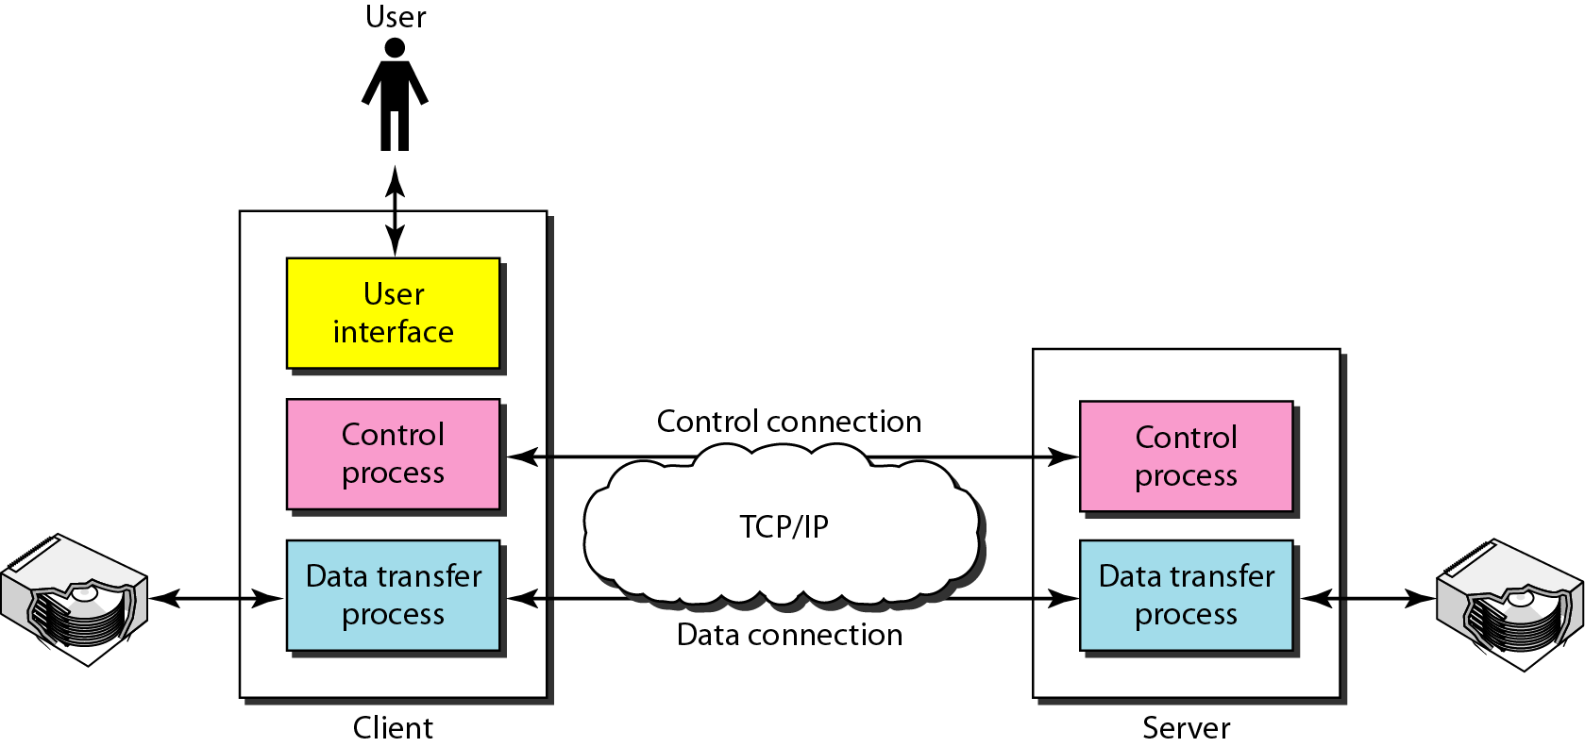
FTP

Slide 76
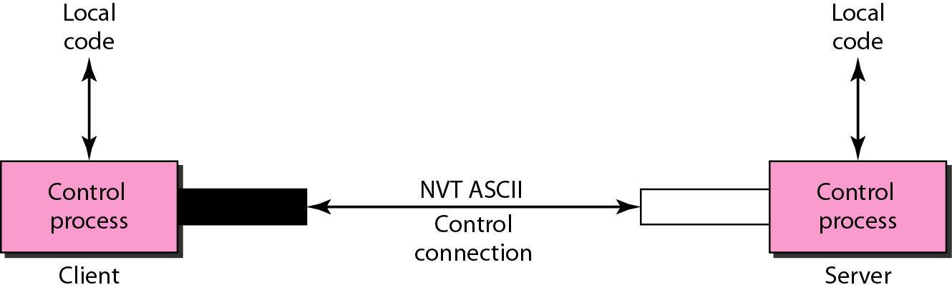
Using the control connection

Slide 77
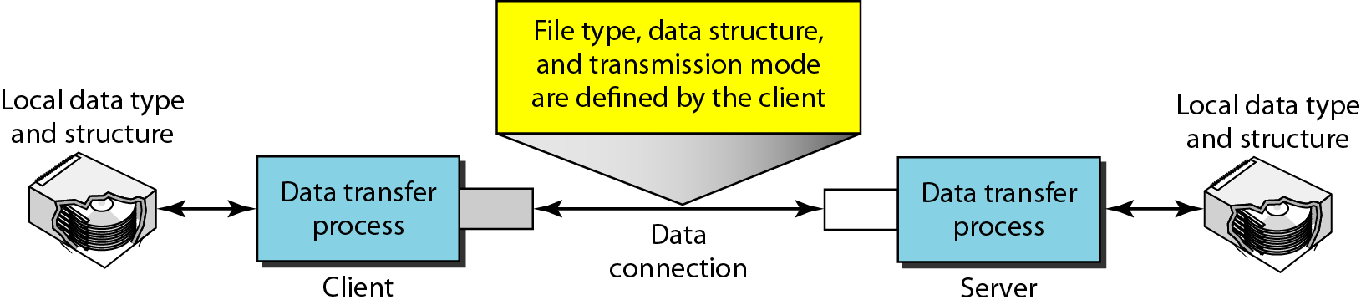
Figure Using the data connection

Slide 78
Example 26.4
The following shows an actual FTP session for retrieving a list of items in a directory. The colored lines show the responses from the server control connection; the black lines show the commands sent by the client. The lines in white with a black background show data transfer.
1. After the control connection is created, the FTP server sends the 220 response.
2. The client sends its name.
3. The server responds with 331.

Slide 79
Example 26.4 (continued)
4. The client sends the password (not shown).
5. The server responds with 230 (user log-in is OK).
6. The client sends the list command (ls reports) to find the list of files on the directory named report.
7. Now the server responds with 150 and opens the data connection.
8. The server then sends the list of the files or directories on the data connection.
9. The client sends a QUIT command.
10. The server responds with 221.

Slide 80
Example

Slide 81
Example
We show an example of anonymous FTP. We assume that some public data are available at internic.net.
We show an example of anonymous FTP. We assume that some public data are available at internic.net.
continued on next slide

Slide 82
Example (continued)

